Slide 1
INSTRUCTIONS:
These slides are your “proposal”.
You must coordinate with the AMMOS Technology Manager, AMMOS Element Manager (AEM) and the Technology Reporting Lead most responsible for your area in developing your proposal. All proposals must be traceable to the AMMOS strategic plan and roadmap and should describe an “on-ramp” to implement the capability within the AMMOS.
Please complete your technology proposal briefing by COB February 24th, 2017
Use the following procedure for submitting your proposal:
Log onto the IDEAS website (https://ammos.jpl.nasa.gov/contributing/callforideas/) and follow the instructions to upload your full proposal slides.
Email the slides to Jay Wyatt (e.jay.wyatt@jpl.nasa.gov).
Please Contact Jay Wyatt (818-354-1414 office or 323-481-9148 cel) if you have any questions.

Slide 2
Data-Driven explorer
AMMOS Technology Proposal - New Task
Proposal - 0020
JPL/Caltech PROPRIETARY
–Not for Public Release or Redistribution
AMMOS Technology Proposal Review

Slide 3
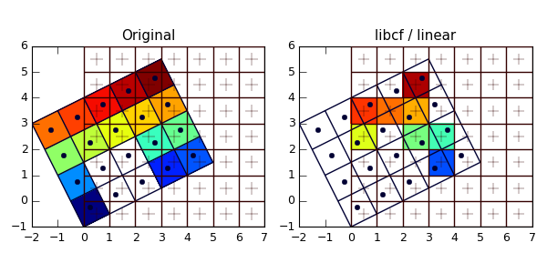
Data-Driven Explorer - 0020
See What’s In The Data
Objective:
Develop automated tool using machine learning techniques to quickly scan mission science and engineering data to reveal structures and problems
Can flag anomalies and/or select best subset of data for later, more detailed analysis
Motivation:
Ops, engineering, science datasets are large & complex
Time-critical need to see data contents & quality
Data problems not immediately noticed since buried in data
Custom data monitors limited; much analysis still manual
Alignment with System Strategic Plan
Addresses following AMMOS System Strategic goals:
Reduce mission operations cost and risk
Fast data problem and anomaly identification
Leverage technological advances in computing
Broadens AMMOS to Support Future Missions
Supports increased data volumes and data rate
Addresses Elements of Systems Strategic Roadmap
High performance queries (s/c data) enabling support for faster operational decisions
System applicable to operations, science data analysis, engineering data analysis and multiple mission phases
Mission Relevance
Users: ☐ Existing Missions ☐ New Missions
List Missions/users: All planetary/Earth missions with large amounts of data downlink (Europa, M2020, SWOT, OCO3, etc.)
Anomaly Detection
Re-grid
Co-locate
Geospatial
Population Explanation
Advanced
Correlation
Linked
Selection
X
X
Benefits
Risk Reduction: Rapidly recognize problems in data
Missing values, unexpected correlations
Changes in data relationships, bi-modality
Identify multiple populations: require statistics analysis
Isolate anomalies: for later study or omission
Search by example: “events like this” in entire dataset
Faster Research Results: Weeks of initial survey removed
Rigorous Stats: Understand incoming data distributions
Broad Applicability: All high-dimensional data consumers
Proposal Category:
☐ Replace/Revitalize Existing AMMOS Capability
☐ New Capability
☐ New AMMOS Capability
☐ AMMOS Infrastructure
☐ Technology
Submitted by: Tara Estlin, 398
Previewed with Chief Engineer or Tech Mgr prior to submission (required) : ☐ Yes ☐ No
X
X

Slide 4
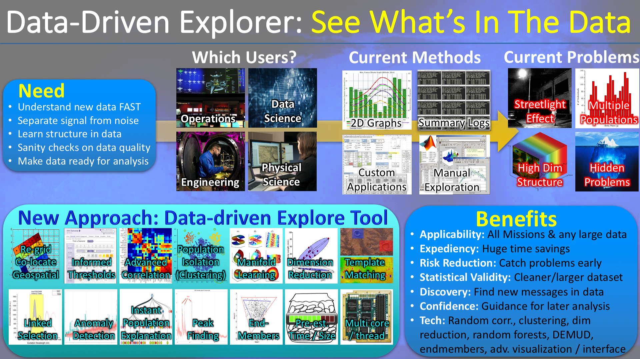
Technology Overview
JPL/Caltech PROPRIETARY
–Not for Public Release or Redistribution
AMMOS Technology Proposal Review

Slide 5
Data-Driven Explorer Proposal Summary
Nature and Significance of the Innovation
Develop new technology for rapid ground exploration of mission instrument science and engineering data to reveal problems and useful data correlations, for example:
Unexpected correlation of measurement with instrument temperature
Impossible bimodal sea surface temperature estimates in the same location
Interactively Identify and remove outliers, anomalies, and artifacts in time-series & spectral data
Identify the most-predictive sensor readings that determine when a system fault develops
Identify anomalies in sets of instrument / mission logfiles
Will use machine learning techniques not previously available to non-data scientists
Brand new approach for enabling instrument engineers and science planners to quickly understand and find problems in their data
Contributes to science operational planning, science analysis and data product generation
Technical Objective
Develop a ground software system prototype that can be used to quickly flag problems and see correlations in downlinked instrument data
Show performance on two illustrative cases (one for science data, one for engineering data)
Technical Approach
Data ingestion for common JPL-utilized formats
Construct intuitive, informative interface that guides/predict before actions are chosen
Parallelize trusted, reliable Machine Learning algorithms to run smoothly in background
Agile development: Grow series of working prototypes with regular engineering / science user testing/feedback
Ever-growing self-test suite of unit tests, demonstrated use-cases, and agile customer needs queue
JPL/Caltech PROPRIETARY
–Not for Public Release or Redistribution
AMMOS Technology Proposal Review

Slide 6
Data-Driven Explorer Proposal Summary
Milestones/Deliverables
FY18: Initial prototype demoing informative interface, 1 science use case, 1 engineering use case
FY19: Advanced prototype demoing science-oriented user tools w/ “research time saved” as metric
FY20: Completed system demoing eng. & sci.-oriented tools w/ “improved response time” as metric
Infusion Plan
Will infuse system prototype into AMMOS catalog as Instrument Data Processing service
Complements current AMMOS science data display, processing and delivery services
Work directly provides AMMOS capabilities for high performance queries (of s/c data) that enable faster operational decisions (part of AMMOS Strategic Plan)
Directly addresses AMMOS strategic goals of
Supporting increased data volumes and data rate – current methods very manual and will not scale to new mission data volumes
Reduce mission operations cost and risk – enables problems to be detected early and more rapid science analysis
Leverage technological advances in computing – applies advanced Machine Learning techniques
Mission Relevance
Multiple current & future missions have time critical needs to evaluate data relations and problems
Will provide critical service for missions with large data volumes and needs for fast data evaluation (OCO-2, OCO-3, NISAR, SWOT, M2020, Europa, etc)
Funding: FY18 (300$k), FY19 (350$k), FY20 (350$k)
JPL/Caltech PROPRIETARY
–Not for Public Release or Redistribution
AMMOS Technology Proposal Review

Slide 7
Data-Driven Explorer Problem Statement
Current State of the Art/State of the Practice
Current methods for understanding new data rely on significant manual analysis / raw scripts
Downlink engineers must manually scan data summary logs, rely on limited 2D graph displays, and use limited, homegrown tools that are redeveloped for each mission
Current process is time consuming and allows hidden problems to slip through
Approach to Address This Limitation
Apply Machine Learning techniques to quickly separate signal from noise, learn data structure, evaluate data quality, and make data ready for analysis
Technology will be developed to handle common JPL data types thus ensuring multi-mission applicability.
Anticipated Performance/Capability Improvement [need to quantify]
Significant reduction in data evaluation time (x2 speed new/initial data version evaluation)
Lowers overall mission risk by catching important problems earlier
Lowers cost and time for later data analysis by 1) providing higher quality data set, 2) finding data correlations and structure early, and 3) identifying outliers as well as related data sets
JPL/Caltech PROPRIETARY
–Not for Public Release or Redistribution
AMMOS Technology Proposal Review

Slide 8
Data-Driven Explorer Entry/Exit Software TRL Assessment
Software TRL Levels
Description
TRL 1 Basic Principles observed and reported. In particular, regarding software, TRL 1 indicates scientific knowledge generated underpinning basic properties of software architecture and mathematical formulation.
TRL 2 Technology concept and/or application formulated. In particular, regarding software, TRL 2 is the point at which invention begins, practical application is identified but is speculative, no experimental proof or detailed analysis is available to support the conjecture, and underlying algorithms are clarified and documented.
TRL 3 Analytical and experimental critical function and/or characteristic proof-of-concept. In particular, regarding software, TRL 3 indicates development of limited functionality to validate critical properties and predictions using non-integrated software components.
TRL 4 Component and/or breadboard validation in laboratory environment. In particular, regarding software, TRL 4 indicates key, functionally critical, software components are integrated, and functionally validated, to establish interoperability and begin architecture development. Relevant Environments and performance in this environment predicted.
TRL 5 Component and/or breadboard validation in relevant environment. In particular, regarding software, TRL 5 indicates End to End Software elements implemented and interfaced with existing systems conforming to target environment, including the target software environment End to End Software System, tested in relevant environment, meets predicted performance; operational environment performance predicted.
TRL 6 System/subsystem model or prototype demonstration in a relevant environment (ground or space). In particular, regarding software, TRL 6 indicates prototype software partially integrated with existing hardware/software systems and demonstrated on full-scale realistic problems.
TRL 7 System prototype demonstration in a space environment. In particular, regarding software, TRL 7 indicates prototype software is fully integrated with operational hardware/software systems demonstrating operational feasibility.
TRL 8 Actual system completed and flight qualified through test and demonstration (ground or space). In particular, regarding software, TRL 8 indicates the final product in its final configuration is successfully demonstrated through test and analysis for its intended operational environment and platform (ground, airborne, or space.)
TRL 9 Actual system flight proven through successful mission opportunities. In particular, regarding software, TRL 9 indicates that the final product is successfully operated in an actual mission.
Machine learning algorithms identified. Some early evaluation of relevant mission data sets.
START
System evaluated on two real mission data sets and working in mission environment. Overall benefits illustrated and quantified.
END
JPL/Caltech PROPRIETARY
–Not for Public Release or Redistribution
AMMOS Technology Proposal Review

Slide 9
Data-Driven Explorer Infusion into the AMMOS
Benefit to the AMMOS: Provides data exploration capability that all missions will need and that cements AMMOS as leader in instrument data services
Infusion Plan
Target AMMOS Subsystem(s):
Strategic Plan/Roadmap Reference:
Target Infusion Date:
Instrument Data Processing
High performance queries [s/c data] enabling support for faster operational decisions
2019/2020
Infusion Plan Detail
Infuse final system into AMMOS catalog as Instrument Data Processing service. Will pattern infusion on complementary AMMOS services already in catalog for science data display, processing and delivery such as the Science Data Infrastructure Service and the Image Processing ToolKit.
Initial target mission customers are OCO-2 and OCO-3 since proposal team already working closely with those missions. System also targeted at large range of missions including Europa, M2020, NISAR, SWOT, etc.
Maps directly to Strategic Roadmap element for “High performance queries [s/c data] enabling support for faster operational decisions.“ Directly addresses AMMOS strategic goals of 1) Reduce mission operations cost and risk, 2) Broaden AMMOS to support future missions (esp for increase in data volumes and rates), 3) Leverage technological advances in computing.
JPL/Caltech PROPRIETARY
–Not for Public Release or Redistribution
AMMOS Technology Proposal Review

Slide 10
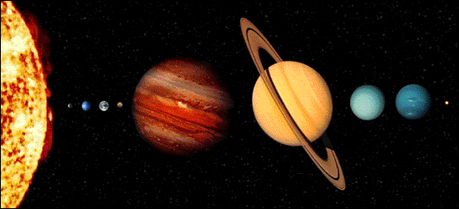
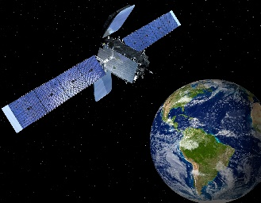
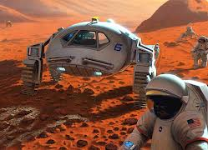
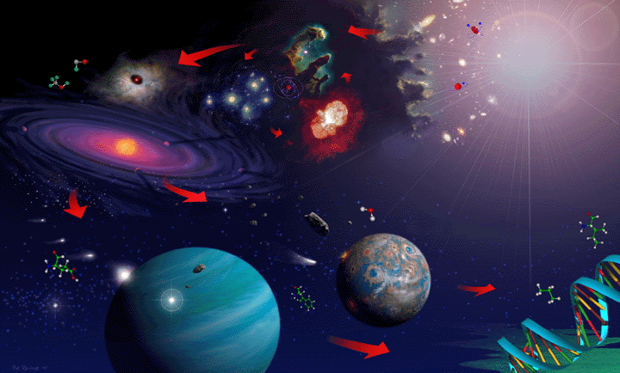
Data-Driven Explorer Mission Relevance
Relevance to Deep Space and Astrophysics Missions
Relevant to large class of Deep Space Missions. Any mission that could benefit from rapid exploration of instrument data to help identify anomalies, separate signal from noise, and find data correlations and structure (which contributes to improved analysis and science product generation).
Potential users include Europa, M2020, ARRM, MAVEN, Lunar Flashlight, etc.
Hyperspectral data especially relevant, common to Astrophysical missions
Relevance to other areas of NASA
Huge application for Earth Orbiters. Interest already expressed by OCO-2 and OCO-3. Can help address high data volume challenges of NISAR and SWOT.
Many missions could use today. Will target readiness for M2020 NISAR (2020) and SWOT (2021).
Magnitude of the Benefit
Significant reduction in data evaluation time – reduce from days to mins/hours
Early identification of anomalies – could save days of ops costs/time
Faster science product generation and analysis – save days of mission science analysis;
At least 50% reduction in time-to-anomaly-discovery and thorough data comparison/checkout functions (currently manual)
PLANETARY SCIENCE & ROBOTIC EXPLORATION*
EARTH SCIENCE
HUMAN EXPLORATION
ASTROPHYSICS*
JPL/Caltech PROPRIETARY
–Not for Public Release or Redistribution
AMMOS Technology Proposal Review

Slide 11
Data-Driven Explorer Resources
Staffing
PI: Tara Estlin
Team: Lukas Mandrake, Zhangfan Xing
Qualifications of Proposal Team: PI has track record of successful AMMOS technology infusion into missions and significant experience in ground data analysis (MER, MSL). Co-I’s have experience in science data analysis, processing, delivery, and data visualization for multiple missions (OCO-2, SMAP, …). Co-I’s have successfully infused past products into the official science data delivery.
Related Work
NSTA’s Advanced Concepts has co-funded $50k in FY17 to seed CODEX initial development as the “#1 most promising Data Science seed task of FY17.”
NSTA also funded hyperspectral-based science pilot using SOFIA/GREAT data for autonomous calibration/spectral correction. CODEX prototypes will facilitate this work, encapsulating a perfect use case.
Team has extensive familiarity and availability with OCO-2 and AVIRIS engineering, pipeline, data formats, contents, and science use cases for realistic testing environments, as well as engineering access to TVAC campaigns
Competing work focus: “big data” / web interfaces; CODEX instead infuses proven data-driven analysis to empower existing experts to be faster and more thorough
Funding Request:
FY18 | FY19 | FY20
$350k | $350k | $350k
JPL/Caltech PROPRIETARY
–Not for Public Release or Redistribution
AMMOS Technology Proposal Review

